Slide 1



Slide 2

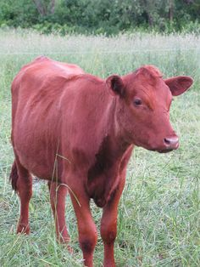
Is there Red Heifer Linkage to –
Yahusha?
Is it -
Colour of the Skin,
- or -
Blood Contact Conformation?

Slide 3
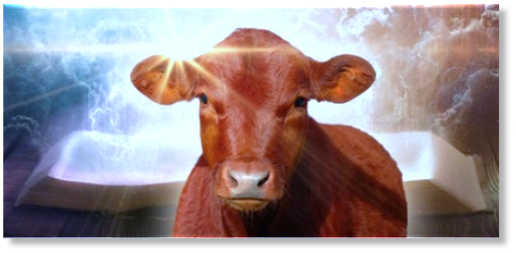
Contents: Part 2
Content for the Red Heifer sacrifice, and its purpose. 4 - 11
Is Red Heifer Type linked to Yahusha ?? 12 – 26
Camp Location Relationship Qualification 27 – 37
The Imposed Veil on the Red Heifer 38 – 57
Sacrifice at the Door of the Tabernacle! 58 – 62
The Altar and That which Sanctifies (the offering.) 63 - 68
The Worm’s Gender Identification and the Ruach!!!!!! 69 – 72
The Worm of the Fire 73 – 79
The Worms of the Scriptures 80 - 85

Slide 4
True Believers speak Yahusha’s life into the world around them through lips that are covered by the blood of Mashiach. The bride of the Mashiach is uniquely His and she is progressively becoming more and more like Him.
How? By examining The MelchiTzedek Covenant and making a persistent effort to align more within that Covenant.
Yahusha was clothed in a SCARLET ROBE to symbolize not only His royalty, but His life and His blood. The word blood in the Scriptures is associated with life. We are told at least twice in Leviticus 17:11 & 14 that the life of all flesh is in the blood.

Slide 5
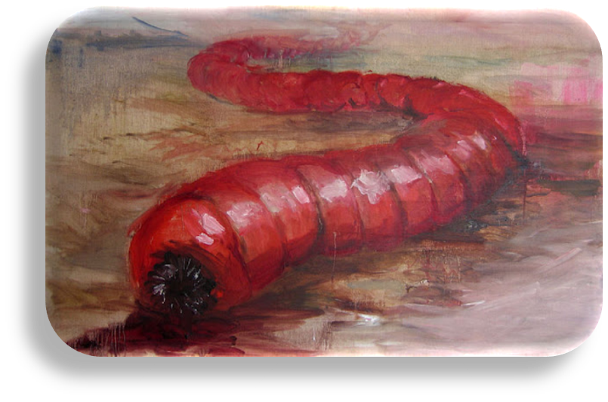
The symbolism of the SCARLET ROBE also provides us with a link to the rider of the white horse in Revelation 19:11-16, the One who is “clothed with a robe dipped in blood, and His name is called
“The Word of Yahuah” (verse 13).
That robe has a name written on it:
“King of Kings, and Master of Masters” (verse 16).
Here we see Yahusha Ha Mashiach, exalted above all, clothed in His spiritual, blood-of-Mashiach -
The SCARLET ROBE.
In other words, He is clothed in LIFE.

Slide 6
But what connection does SCARLET have
with - a Red Heifer offering?
The instructions concerning the Red Heifer are found primarily in Numbers 19.
What is the symbology of the
Red Heifer in view of Yahusha?

Slide 7

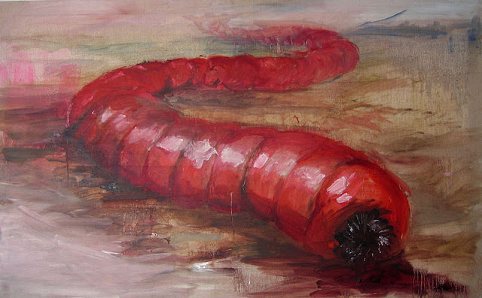
What about the “RED” (heifer) requirement? Do we read of an event in the life of Yahusha that directly reflects this Divine requisite?
Matt 27:28 And having stripped Him, they
put a scarlet robe on Him.
Why scarlet?
Why a WORM?
Stay tuned!

Slide 8
A closer look at that Robe of Mocking Authority!
Matt 27:28 And^{G2532} they stripped^{G1562} him,^{G846} and put on^{G4060} him^{G846} a scarlet^{G2847} robe.^{G5511} [military cloak]
Matt 27:31 And^{G2532} after^{G3753} that they had mocked^{G1702} him,^{G846} they took^{G1562} the^{G3588} robe^{G5511} [military cloak] off from^{G1562} him,^{G846} and^{G2532} put^{G1746} his own^{G846} raiment^{G2440} on him,^{G846} and^{G2532} led him away^{G520 G846} to crucify^{G4717} him.
The brilliant red military cloak was specifically to mock His authority.

Slide 9

Robe of Scarlet
A Heifer,
and a Worm??

Slide 10
Why the Divine requirement for a RED heifer?
Could not a black or white or even a fancy spotted one provide the same BLOOD quantity, and/or,
prophetic cleansing QUALITY within the ashes?
What specific reason(s) did Yahuah have in mind when He stipulated, by statute, a “RED” heifer?

Slide 11
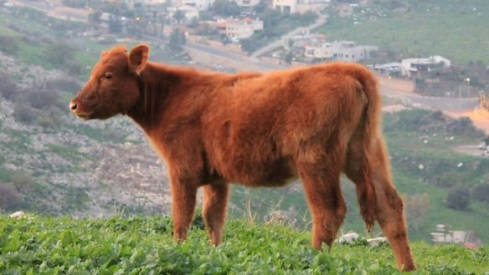
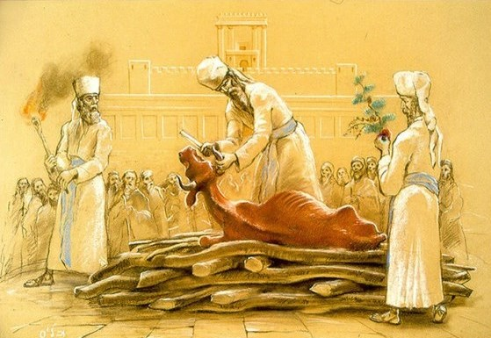
1 John 5:8
And there are three that bear witness in earth, the spirit, and the water, and the blood: and these three agree in one. KJV
Yah’s spirit is His breath; the water and blood are from Him … these 3 are witnesses on this EARTH to the
ONE ULTIMATE SACRIFICE.

Slide 12
Can this earthly Red Heifer sacrifice, which had the capability to cleanse complete nations, be metaphorically compared to Yahusha Ha Mashiach’s Ultimate Sacrifice, which can and will cleanse, forgive and heal anyone willing?

Slide 13
The Red Heifer – A Sin Offering
The full purpose of the Red Heifer offering was for purification
of sin, and to remove defilement from contact with a dead body.
Num 19:9 ‘And a clean man shall gather up the ashes of the heifer, and shall place them outside the camp in a clean place. And they shall be kept for the congregation of the children of Yisra’ĕl
for the water for uncleanness, it is for cleansing from sin.
The red heifer ashes mixed with water, were to cleanse people who were unclean and defiled.
And what of the SCARLET/CRIMSON thrown into the Red Heifer sacrifice fire?
Was there a purpose for this?

Slide 14
Psalms 22 Prophecy of the Trials Surrounding Gabbatha
6 But I am a worm, [Tolah/scarlet] and no man; a reproach of men, and despised of the people.
7 All they that see me laugh me to scorn: they shoot out the lip, they shake the head saying,
8 He trusted on [Yahuah] that he would deliver him: let him deliver him, seeing he delighted in him.
9 But thou art he that took me out of the womb: thou didst make me hope when I was upon my mother's breasts.
10 I was cast upon thee from the womb: thou art my [Elohim] from my mother's belly.
11 Be not far from me; for trouble is near; for there is none to help.
12 Many bulls have compassed me: strong bulls of Bashan have beset me round.
13 They gaped upon me with their mouths, as a ravening and a roaring lion.
14 I am poured out like water, and all my bones are out of joint: my heart is like wax; it is melted in the midst of my bowels.

Slide 15

Can “Scarlet/Crimson” Cleanse - Naturally?
This is a prophecy of the Messiah and here we see that [Yahusha] called Himself a "worm." In the Hebrew this is the "Tolah" worm or Crimson Worm; in Latin it is the "Coccus Illicus" that climbs into the Hermes Oak, and dies for its children; staining the tree red for three days. The word "finished" in the original Greek means “paid in full.” "We owed a debt we could never pay" and [Yahusha] "paid a debt He didn't owe" for us. Sin no longer has dominion over us if we accept His sacrifice for us
as noted in Romans 6:14.
"... the crushed ìcoccus ilicisî contains a chemical that is an anti-bacterial agent which is why it was used in two types of purification ceremonies:
When there was a plague, scarlet was included in the purification of the house.
And he shall cleanse the house with the blood of the bird, and with the running water, and with the living bird, and with the cedar wood, and with the hyssop,
and with the scarlet (Lev 14:52).

Slide 16
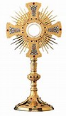
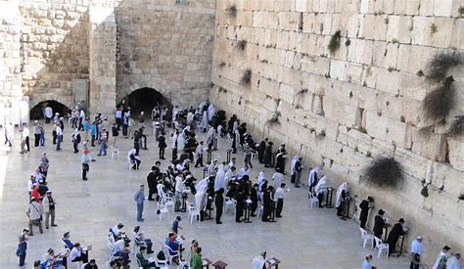
The Red Heifer ashes cleansed from contact with a dead body.
But Yahusha’s Ultimate Sacrifice is so much more!
The Mashiach’s Sacrifice cleanses from a dead body also!
The Dead Bodies of
Syncretism and Paganism!

Slide 17
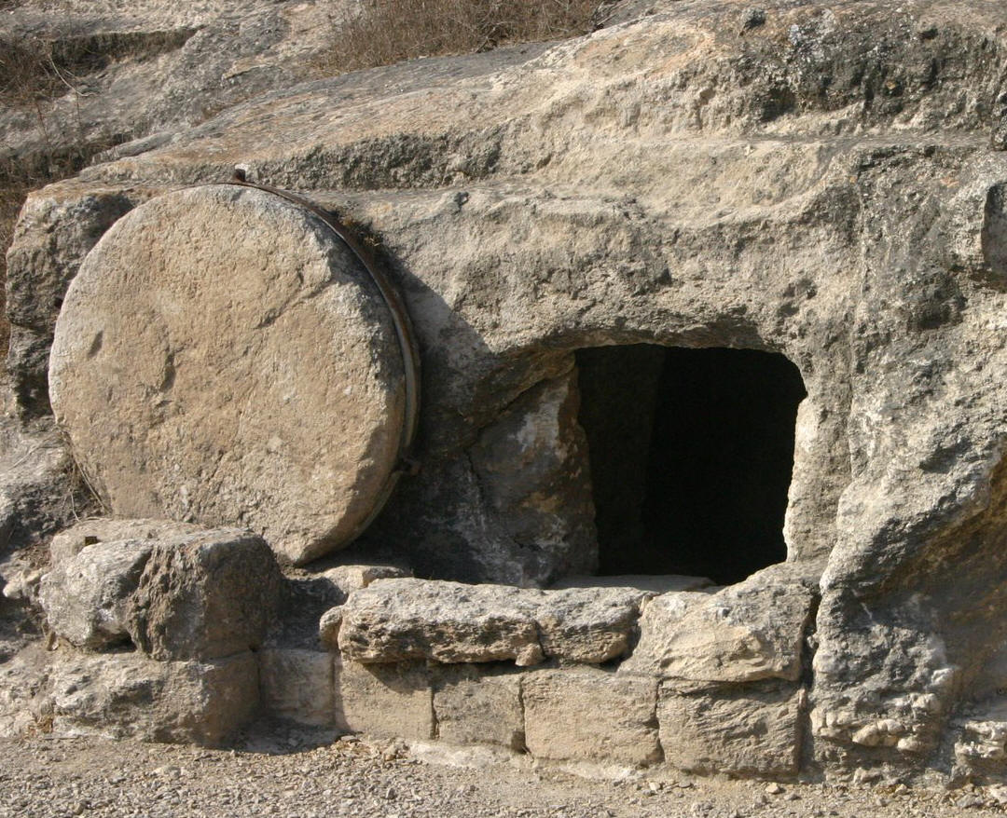
The Red Heifer, is it effective after-Yahusha’s death?
Passion Week (?)
slain by a sword or who has died, or a bone of a man, or a grave, is unclean for seven days.
Num 19:16 Anyone in the open field who touches someone
Mary was in the tomb – Luke 23:55.
Luk 23:55 And the women who had come with Him from Galil followed after,
and saw the tomb and how His body was laid.

Slide 18
Passion Week !
Note:
Yahusha presented Himself to Mary Magdalene just before Dawn when it was still dark on the first cycle of the week {Shabbathown –
& in Roman Reckoning}, John 20:17.
He commanded Mary NOT to touch Him!
On the next slide we will see a clear Scriptural reason for
Yahusha’s command to Mary.
Mary did not necessarily need to physically touch the body of Yahusha while inspecting His burial process, but indeed she was inside the tomb to oversee proper cultural burial etiquette.
Was Mary unclean at that moment, on Passover – Abib 14, the burial PREPARATION NIGHT? (Luke 23:54)

Slide 19
Complications Concerning Death
Num 19:14 This is the Torah when a man dies in a tent: All who come into the tent and all who are in the tent are unclean for seven days.
Mary was in the clean tomb - inspecting. Was she then unclean?
As with the normal death of a human being, it would be 7 cycles (days) before she could be clean once again.
It was imperative for Yahusha to command Mary NOT TO TOUCH Him prior to presenting Himself in the heavenly court, before Yahuah (Ex 23:17), as the Ultimate FLAWLESS Sacrifice (Num 19:2, Exo 12:5).
Yahusha – The First Fruit (1 Cor 15:23) - would not jeopardize our
Salvation. He simply would not allow defilement.

Slide 20
Complications Concerning Death
Dan 9:27 And he shall make a firm covenant with many for one week: and in the midst of the week He shall cause the sacrifice and the oblation to cease; and upon the wing of abominations shall come one that maketh desolate; and even unto the full end, and that determined, shall wrath be poured out upon the desolate.
In light of the Red Heifer statutes, -
Was Mary contaminated from inspecting Yahusha’s burial process?
No, the sacrifices had been terminated by the death of Yahusha.
There was no more possibility to be cleansed by the water and ashes mixture of the Red Heifer!
Mary was simply, as a human being - a sinner.
Yahusha could not be defiled by a sinner in any way.
The Red Heifer statutes had no bearing on this meeting at Dawn!

Slide 21
The Red Heifer? Can it resemble -Yahusha?
Num 19:2 “This is a law of the Torah which יהוה [Yahuah] has commanded, saying, ‘Speak to the children of Yisra’ĕl, that they bring you a red heifer, A PERFECT ONE,
This command (law – H2708 chqth) is a statute which has an eternal application and definition. H2708 usually pertains to The Bride!
Since the Book of the Law, was a temporary guideline; this H2708 statute command must pertain directly to the Red Heifer - being a Perfect One, that with the Bride, will remain throughout eternity.
in which there is no blemish and on which a yoke has never come.’”
Parallel to Exo 12:5 – The Perfect Passover Lamb (Yahusha?)

Slide 22
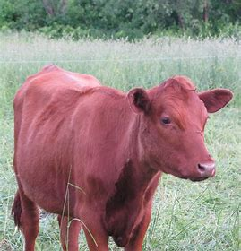

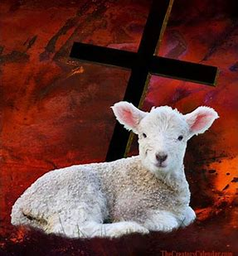
Again - The Red Heifer? Does it resemble -Yahusha?
Note: The Red Heifer must remain Flawless; never forced
{coerced nor yoked} into works (involuntary labour/traditions of man).
RECALL - 40 days Ha Satan imposed his evil Temptations upon Yahusha,
AND FAILED!
Yes Yahusha remained - PERFECT - FLAWLESS!
Mar 1:13 And He was there in the wilderness forty days, tried by Satan, and was with the wild beasts. And the messengers attended Him.

Slide 23

A Red Heifer - Characteristic!
Yahusha?
The Red Heifer - MUST have
VOLUNTARILY laid up its life –
for the purpose of removing sin from mankind.
John 10:15 even as the Father knows Me, and I know the Father. And I lay down My life for the sheep.
John 10:17 “Because of this the Father loves Me, because
I lay down My life, in order to receive it again.

Slide 24
Will the Red Heifer Yoke qualification eliminate -Yahusha?
Yahusha never was “yoked” by another individual into offering His life for the salvation of mankind. It was always, a volunteered personal offering of His own choice. He was never “yoked” (SNARED) into the BURDEN OF HUMAN (Sanhedrin) DOGMATIC DECEPTIONS!
1 John 3:16 By this we have known love, because
He laid down His life for us.
And we ought to lay down our lives for the brothers.
No, the statute of “no yoke” does not eliminate, but effectively qualifies Yahusha, as the candidate for the Red Heifer antitype.

Slide 25
Having experience on a ranch, when a bovine is treated extraordinarily well, for some reason that animal willingly without reservation or resistance, will follow its leader.
Question: Did Yahusha also voluntarily give up His life for mankind without resistance?
Acts 8:32 And the passage of the Scripture which he was reading was this, “He was led as a sheep to slaughter, and like a lamb silent before its shearer, so He opened not His mouth.”

Slide 26

Do we blame the earthly powers?
Are we correct in stating that the Pharisees and Sadducees forcefully tortured Yahusha before taking His life? Yes? … and no?!
Yes, they carried out their evil intentions! However it was only that Yahusha allowed it to happen that they were able to crucify Him.
We would do good to remember John’s recordings.
John 18:6 When, therefore, He said to them, “I am,”
they drew back and fell to the ground.
Simply by voice, in identifying Himself as Yahusha,
the earthly men hit the dirt. (See John 19:10,11 also.)
The rabble men had zero power over Yahusha! His SACRIFICE was fully volunteered!

Slide 27

Next:
The “Camp Relationship” qualification.
Where does Yahusha stand?

Slide 28

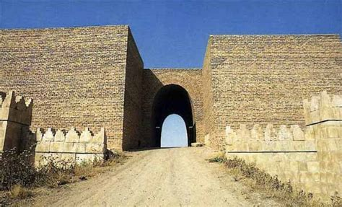

The Red Heifer & Yahusha Crucified - Where?
Num 19:3 ‘And you shall give it to Elʽazar the priest, and he shall bring it outside the camp,
and shall slaughter it before him.
El’azar, the “prince of priests” (or chief priest – Num 3:32) was to take the red heifer outside the camp to perform the burnt offering there before his very eyes. (“Prince” –JPS)
And what of our Mashiach, where was He crucified?
And so יהושע [Yahusha] also suffered outside the gate,
to set apart the people with His own blood.
Heb 13:12 Directly connects Yahusha to the R/H,

Slide 29
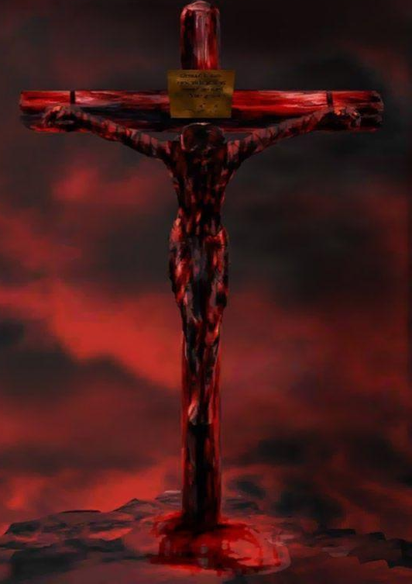
Red Heifer Blood & - Yahusha’s Blood!
Heb 13:12 … יהושע [Yahusha] …
to set apart the people with His own blood.
Is it possible to see a similar link exposing a direct connection between the command to INCLUDE the Red Heifer’s blood in the burnt offering - and –
Yahusha offering His BLOOD specifically to atone (cleanse) for the sins of mankind?
LIFE
Other sacrifices saw the blood removed!

Slide 30
High Priest Must Officiate the Red Heifer Sacrifice
The chief of priests, - MUST BE PRESENT - at this sin offering.
Question: Which Kohen Ha Gadol (High Priest) presided over the
voluntary Passover Lamb offering for the Salvation of mankind?
Qayapha, by default of purposely renting his priestly garment, immediately eliminated himself as an authentic Kohen Ha Gadol. (High Priest)
Yahusha, THE Kohen Ha Gadol under the MelchiTzedeq Order,
was the ONLY authentic (Qadosh) High Priest in existence at the time of the Abib 14 Passover - at Golgotha!
Where was Golgotha located?

Slide 31
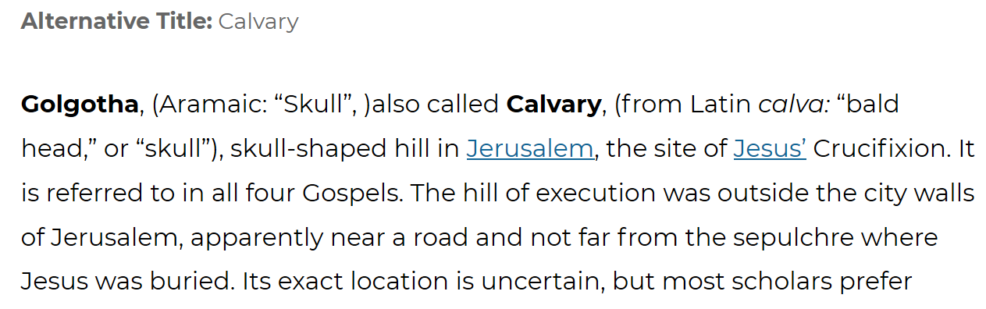
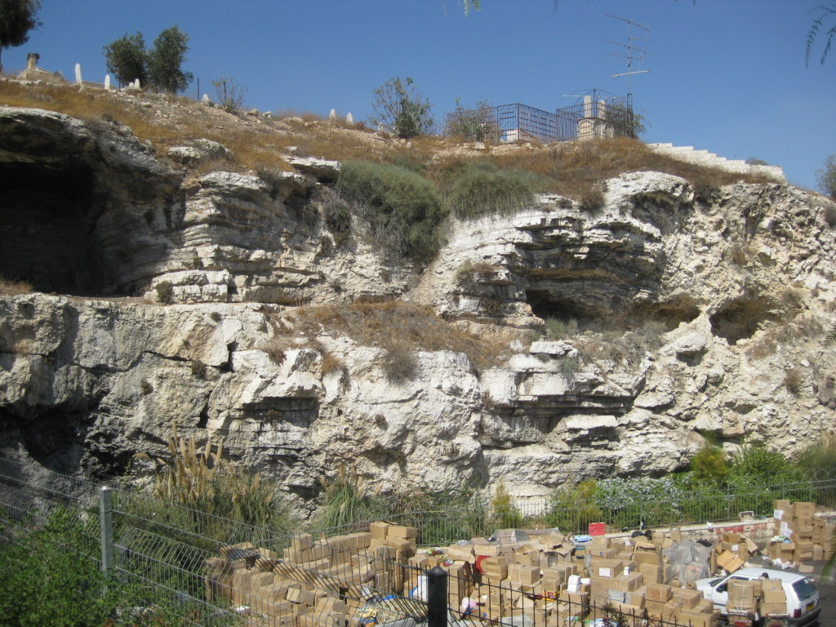
Golgotha is Where?
Yahusha’s
Yahusha
Golgotha (“place of the skull”), were Yahusha was crucified
was outside the city of Jerusalem.
This factor infinitely equates to the red heifer offering which also, by statute, was to be burned outside the Hebrew camp. Num 19:3

Slide 32
The Red Heifer’s Blood?
Num 19:4 ‘And Elʽazar the priest shall take some of its blood with his finger, and sprinkle some of its blood SEVEN TIMES
toward the front of the Tent of Meeting.
But Golgotha, often named Calvary, is on the other side of Jerusalem, just outside the eastern wall, northeast of the Temple Mount. Golgotha - Place of a Skull
Golgotha Rediscovered
golgotha.eu/
The “seven times” symbolizes the 7 locations on His body where He shed blood, and also the Perfect Number of the Plan of Salvation.

Slide 33
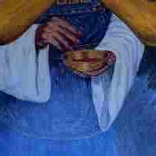
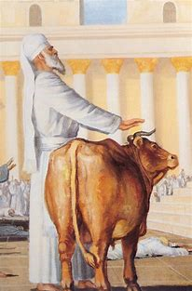
Seven times the Red Heifer blood was sprinkled …
1. Sweat blood - Gethsemane
2. Head - crown of thorns
3. Hands (x2) – crucifixion
4. Feet (x2) - crucifixion
5. Impaled - crucifixion
Yahusha’s loss of blood -
The Qodesh Red Heifer Type/Pattern – DUPLICATED!
Luke 22:44
Matt 27:29
John 20:25
Luke 24:39,40
John 19:34
Where, in terms of the Temple location did these final events occur?

Slide 34
The Location of the Red Heifer offering?
Num 19:4 And Elʽazar the priest shall take some of its blood with his finger, and sprinkle some of its blood SEVEN TIMES
How can we understand this to be as stated?
Matt 27:50 And יהושע [Yahusha] cried out again with a loud voice, and gave
up His spirit.
Matt 27:51 And see, the veil of the Dwelling Place was torn in two from top to bottom, and the earth was shaken, and the rocks were split …
Review
TOWARD THE FRONT of the Tent of Meeting.
Yahusha also shed His blood - on top of the Hill of Golgotha outside of the city, with a full frontal view of the Tabernacle.

Slide 35
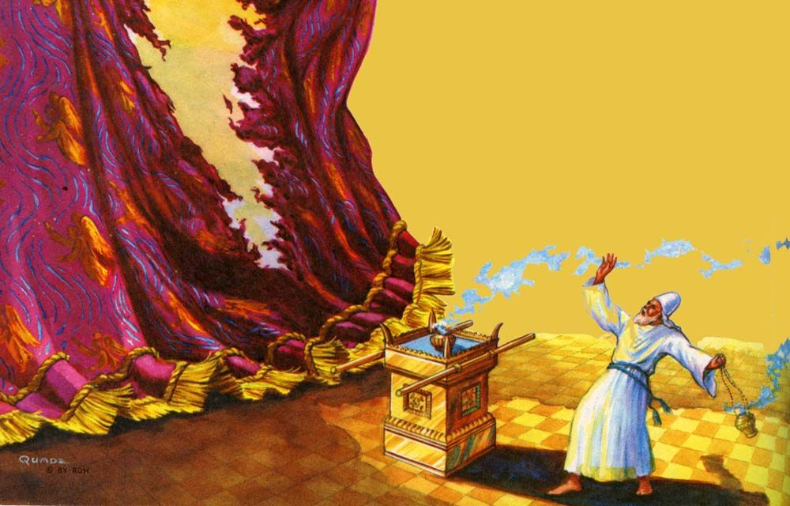
Who Witnessed these events?
Matt 27:54 And when the captain and those with him, who were guarding יהושע [Yahusha] SAW the earthquake
AND ALL THAT TOOK PLACE,
they feared exceedingly, saying,
“Truly this was the Son of Elohim!”
The Centurion (captain) seeing all that took place, which includes the “renting in twain of the veil, from TOP to BOTTOM,” was by necessity, facing a full frontal view of the Tabernacle!
Could Yahusha’s offering qualify as the Antitype? It was outside the city. It was facing the front of the Tabernacle. Could Yahusha’s BLOOD offering compliment or – FULFILL – the Red Heifer Type ?

Slide 36

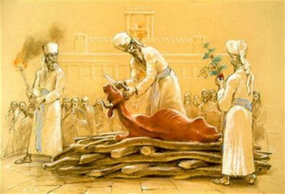
The Red Heifer’s Body - Completely?
Num 19:5 And the heifer shall be burned before his eyes – he burns its hide, and its flesh, and its blood, and its dung.
The whole body was to be offered for the cleansing from sin.
Not one part was to be omitted.
The offering was to be performed in full view of the Chief of Priests.

Slide 37
The Red Heifer’s Blood Too?
The blood of the heifer was an important integral part of the offering.
This blood was commanded to be burnt with the offering (Num 19:5.)
How does this relate to our Mashiach?
Heb 9:14 How much more shall the blood of the Messiah, who through the everlasting Spirit offered Himself unblemished to Elohim, cleanse your conscience from DEAD WORKS
to serve the living Elohim?
The red heifer offering had
also, a physical import.
Yahusha’s blood offering was much more than a physical offering, it ultra importantly, primarily operated on a fully spiritual basis.
At Dawn, the 1st cycle of the week, John 20:17, Yahusha stood before Yahuah as the Perfect Sacrifice! After the resurrection He being Flawless, became the First-fruit offering on - Wave Sheaf Day!

Slide 38
Has there been a veil insidiously imposed upon the
Red Heifer Sacrifice?

Slide 39
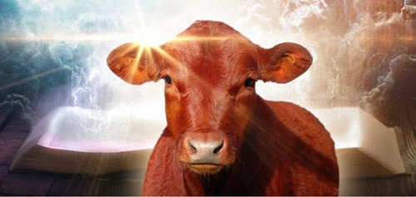
The Significance of Yahusha’s Blood Offering!
Matt 26:27 Then He took the cup and gave thanks, and gave it to them and said, Take, drink of it, all of you.
Matt 26:28 THIS IS MY BLOOD OF THE NEW COVENANT which is shed for many FOR THE REMISSION OF SINS.
See also Mark 14:24; Luke 22:20.
Question: What does Yahuah reveal in the Torah
about the foundational import of the blood?
Lev 17:11 For the LIFE of the flesh is in the BLOOD: and I have given it to you upon the altar to make an atonement for your souls: for it is the blood that maketh an atonement for the soul.
Is this a prophecy of Yahusha’s Sacrifice?

Slide 40
Lev 17:11
For the LIFE of the flesh is in the BLOOD:
Why is it then that people concentrate on the COLOUR OF SKIN AND HAIR
for the “red heifer” offering?
The next 4 slides are a review from Part1, and then, for some Very Revealing information!

Slide 41







Review – pt.1
Instead of “eglah”
being translated as “heifer”,
we read “parah”
which is the same word used to describe Abraham.
The word “parah”
which is translated as “heifer,” clearly means: “fruitful” according to all Hebrew lexicons. This was also the case regarding the blessing promised to Abraham – to be - fruitful.
(heh lamed gimmel ayin)
(heh resh pey)
(heh resh pey)

Slide 42




Review – pt.1
The word “parah” is associated with Egypt and Joseph.
It was in Egypt that Joseph flourished.
Prior to his death, Israel spoke prophetic words and blessings over all of his sons.
The first words spoken over Joseph were: Gen 49:22 Joseph is a fruitful bough, even a fruitful bough by a well; whose branches run over the wall. KJV
Many translations describe Joseph as a “fruitful bough,” but in Hebrew it reads “parote ben.”
The word “ben” is literally “son.” Joseph is emphatically described as a “fruitful son.” That would make him a very fruitful man like Abraham.
(nun beit tav vav resh pey)
(nun beit)

Slide 43



Review – pt.1
How does all of this information compare to the “red heifer”?
The mysterious “red heifer,” is known as a “parah [fruitful] adamah.”
The word “adamah” means “ground.”
Note the connection with the first man “adam” who was specifically named after the origin of his being – the ground. Adam was literally formed from “the dust of the ground” (Gen 2:7). The word for “dust” is “aphar” , which also means: “ashes”!
So, Adam was actually taken from the “ashes ” , of the ground .
Please keep in mind, the red heifer was transformed into “ashes!”
(heh mem dalet aleph)
(heh resh pey)
(heh mem dalet aleph)
(resh pey ayin)
(resh pey ayin)
(heh mem dalet aleph)

Slide 44
Review – pt.1
Clearly there is a connection with man and the “red heifer” sacrifice!
The word “adam” means: “man.” When looking closer, the word “dam” means “blood.”
Therefore, the emphasis of this sacrifice is clearly ON THE BLOOD [itself]
NOT THE COLOR!
AND, [ULTIMATELY], it is the BLOOD contained within “adam” (man), not the blood of an animal – that is being emphasized!
Is there also a connection from the red heifer
to - Yahusha Ha Mashiach?
(mem dalet aleph)
(mem dalet)

Slide 45
Revealing the Blood information next!

Slide 46
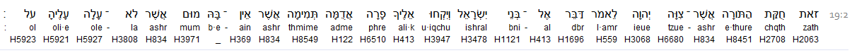
Is DOM actually referencing the colour of the skin on the heifer?
Numbers 19:2
Could it be that the blood is that which
– DOM?
Adme H122 is translated to us as Red.
DAM H1818 (inside this word) is translated to us as – BLOOD.
ACCOMPLISHES
Question: Is the word DOM - blood? Is this a real description of DOM? We must remember that Hebrew is an action based language.
What if DOM DESCRIBES A CONTINUOUS ACTION that occurs WITHIN the heifer?
What implication to Salvation would this action contain? And to Whom would it indicate?

Slide 47
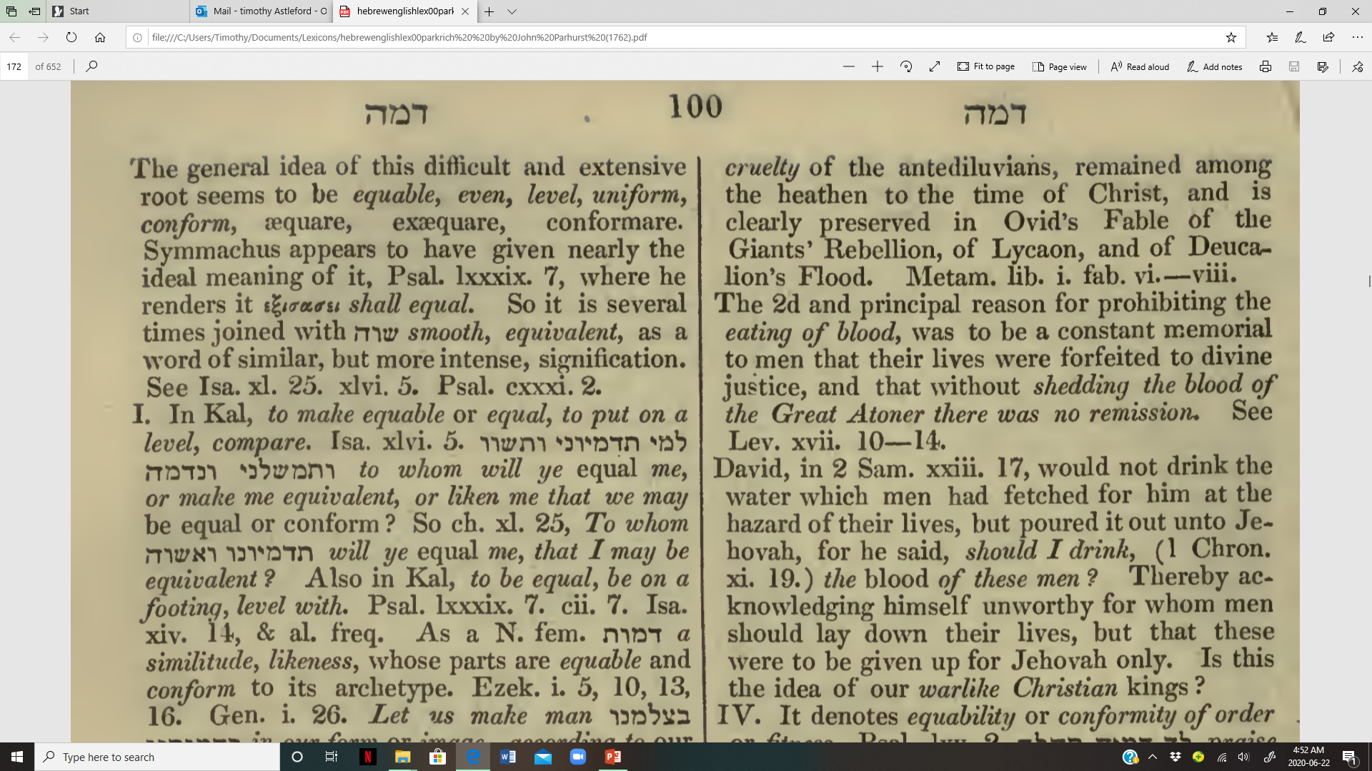
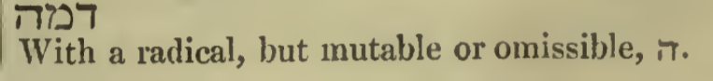
J Parkhurst 1762
A Hebrew Lexicon pg.100
Let’s look at the definitions of this complex root word – DOM, which is translated to us as – BLOOD.
What is the purpose and action of BLOOD?
What part(s) of the BODY does the blood NOT connect with? ANY?

Slide 48
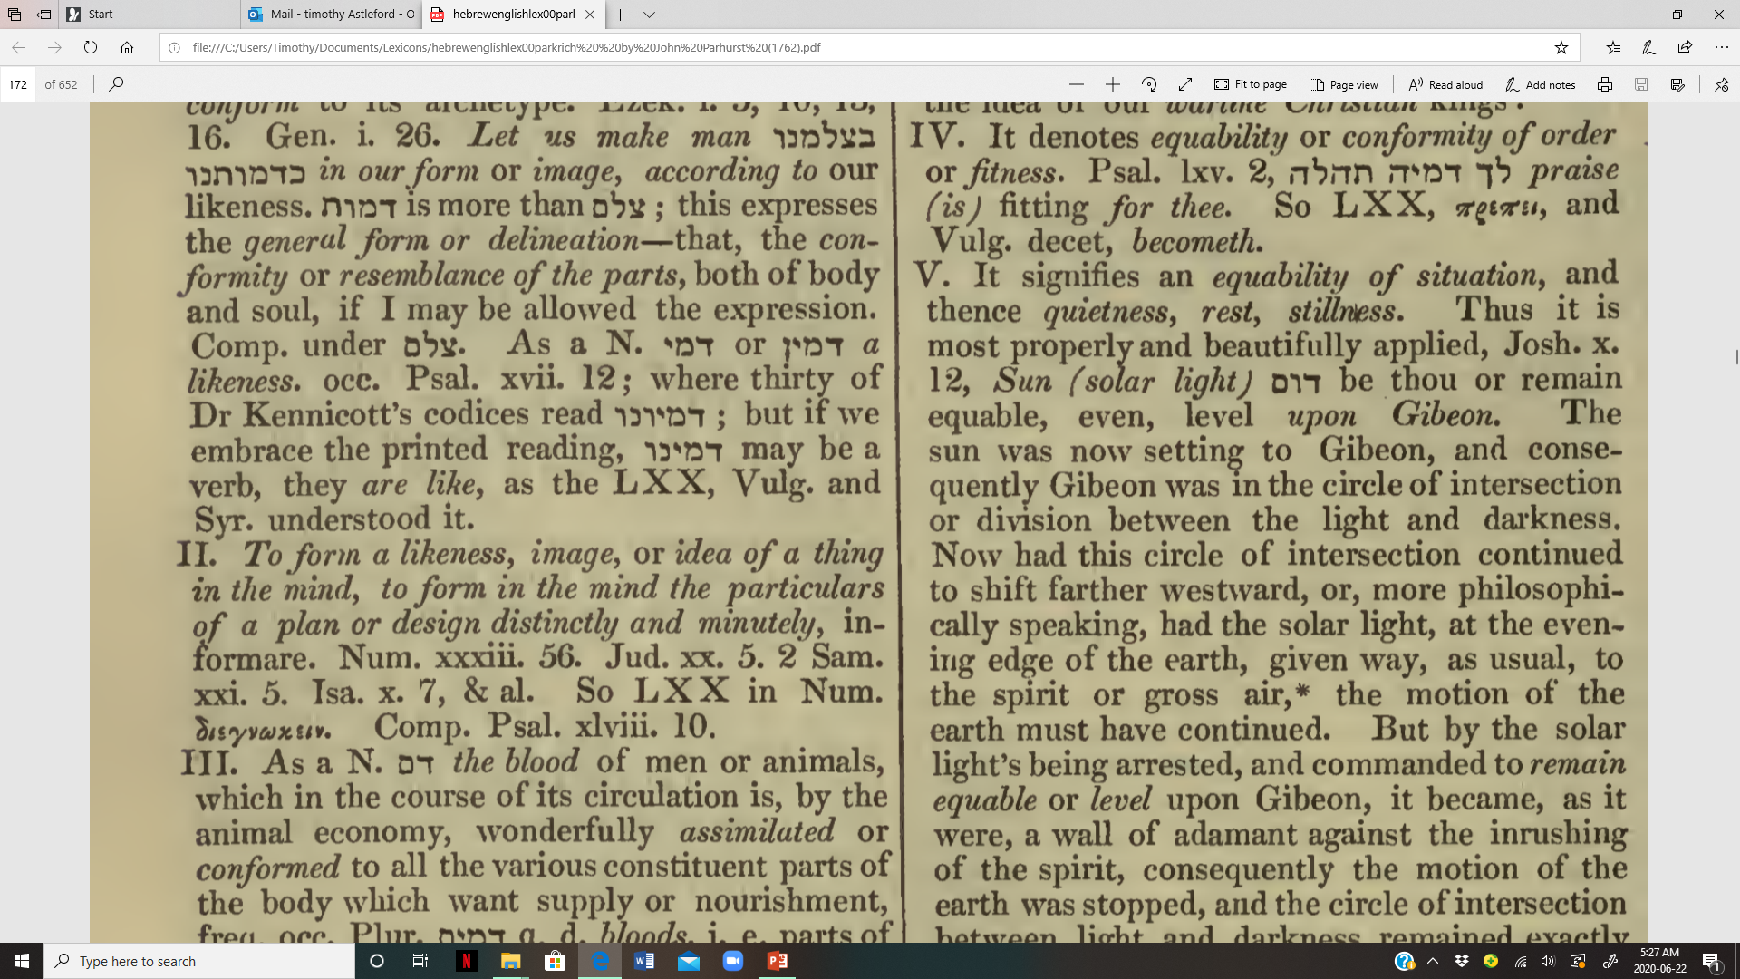
J Parkhurst 1762
A Hebrew Lexicon pg.100
Of course the physical aspect comes to mind. But what about the spiritual construct?
Does the RED SKIN of the heifer contact (DELIVER LIFE TO) the heart, the liver, the lungs, THE BRAIN, etc. etc.?
What about the BLOOD? Does the blood, CONFORM to each and every part of the body, delivering oxygen among other essentials to each one? Is the BLOOD, the equalizing factor that permits every organ
(& minute particle) of the body to LIVE?
Is the SKIN, also capable of “servicing” each and every portion of THE BODY? Think - The physical body AND the BODY – The BRIDE!

Slide 49
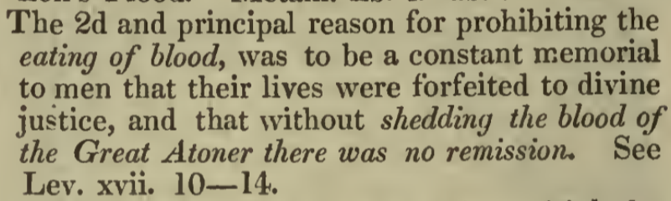
J Parkhurst 1762 A Hebrew Lexicon pg.101
The ingesting of blood is strictly prohibited. What about the skin?
Was there ever a time in the Scriptures where shedding of the skin became ultra important?
In the hours before His Crucifixion, what substance did Yahusha SHED during His deep prayer? Was it skin, or drops of BLOOD?
Is it possible that the focus of the red heifer has been shifted from the thorough internal unifying blood contact for every portion of the BODY,
Refocused To - the colour of the surface – the skin & hair?
Has there been a veil purposely drawn over the Red Heifer Sacrifice?

Slide 50
Are we able to equate the unifying connection of blood to the internal body parts of the heifer, - to –
Yahusha Ha Mashiach who ALSO has full and complete spiritual contact/connection with each and every person within the BODY of the MelchiTzedek Administration?
Does this Divine Connecting factor ALSO supply LIFE to His Body – His Chosen Priesthood?
Is this “red” heifer sacrifice becoming
VERY SIGNIFICANT?

Slide 51
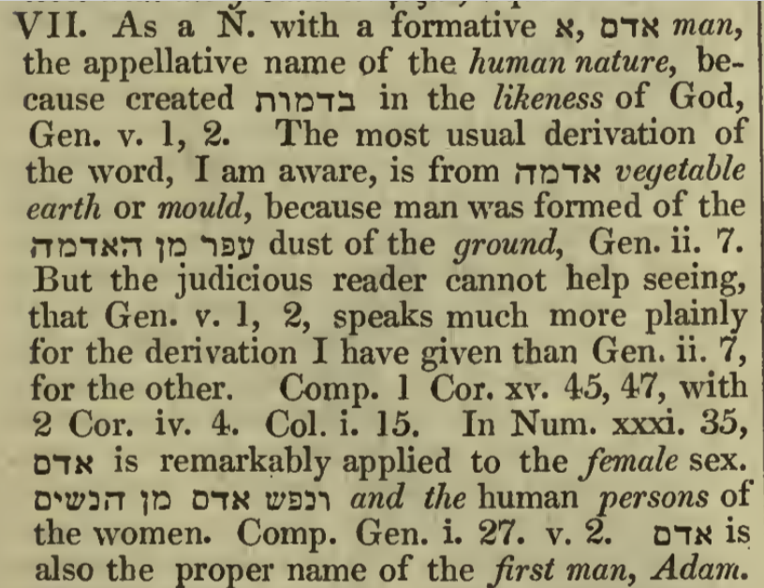
A-Dam
J Parkhurst 1762
A Hebrew Lexicon pg.101
Upon reading Gen 5:2, we see that the categorical term –adam - was applied by Yahuah to BOTH the first man and woman. While their form was somewhat different, their substance was identical.

Slide 52
A-Dam
Is it possible that we have been duped into considering only the colour of the skin, making sure there was less than three hairs total, on the animal that are not “red”?
Have we been misled on the extreme importance of – DOM – the uniting factor that conforms, connects and unifies each and every organ of The Body?
If we find that the red heifer blood was a symbolic type of Yahusha, the Cleanser and the Paschal Sacrifice, are we able to realize that Yahusha IS the – DOM, the UNIFYING FACTOR, the KOHEN HA GADOL, the RUACH HA QODESH which connects, unifies and supplies LIFE to every individual within the
BODY of His people?

Slide 53
Looking at the Relevance of a Blood Offering! (#2)
Lev 17:11 For the LIFE of the flesh is in the BLOOD:
and I have given it to you upon the altar to make an atonement for your souls:
for it is the BLOOD that maketh an atonement for the soul.
Our salvation is purely dependant on Yahusha’s BLOOD offering
made on the tree - outside of Jerusalem.
Yahusha’s BLOOD was offered as a means of cleansing our souls from the sins we inflict upon ourselves while living in this world.
Yahusha’s BLOOD ALONE - is able to cleanse us to the point
of acceptability to stand before Yahuah!

Slide 54
Looking at the Relevance of a Blood Offering! (#3)
John 6:54 Whoso eateth my flesh, and drinketh my blood, hath eternal life; and I will raise him up at the last day.
In the proper application; our physical ingesting of the juice from the vine exposes our comprehension that the blood shed by Yahusha, contains the miraculous healing and cleansing effect that removes the stain of sin from our lives.
Question: Could the actual ashes from a burnt heifer blood offering really cleanse a person from defilement?
Or - did the addition of the double dipped crimson fabric to the heat of the heifer fire link to a deep spiritual connection to Yahusha the ONE and ONLY
who could permanently remove the stain of sin?
Why this?

Slide 55
The Red Heifer - with its Blood Offering!
Please note that all other sacrifices had the blood removed and placed elsewhere. The blood was either proportionally sprinkled and poured out onto the ground, or it was fully poured onto the ground.
Yet - the Red Heifer offering blood, was proportionally sprinkled and the BULK OF THE BLOOD WAS BURNED WITH THE SACRIFICE!
What about Yahusha? Was His blood not “Proportionally Sprinkled” (7 times) through the sweating of blood and also the physical abuse of His body, yet the bulk of His blood remained inside of His body throughout the sacrifice?
Are we able to see a direct correlation between the Red Heifer sacrifice and Yahusha’s Sacrifice in the amount of blood spilled?

Slide 56

The Red Heifer – an Ascent Offering?
What was the significance of the red heifer burnt offering?
Or – The Red Heifer ASCENT offering!
Symbolically see …
Yahusha?
Yahuah?
Num 19:9 ‘And a clean man shall gather up THE ASHES
of the heifer, and shall place them outside the camp in a clean place.
And they shall be kept for the congregation of the children of Yisra’ĕl
for the water for uncleanness, it is for cleansing from sin.
Heaven?
Heaven?
Of life, never thirst… ?
Yahusha!

Slide 57
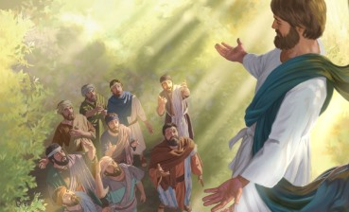
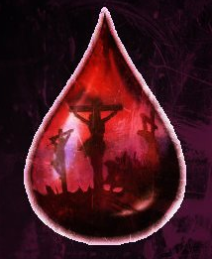
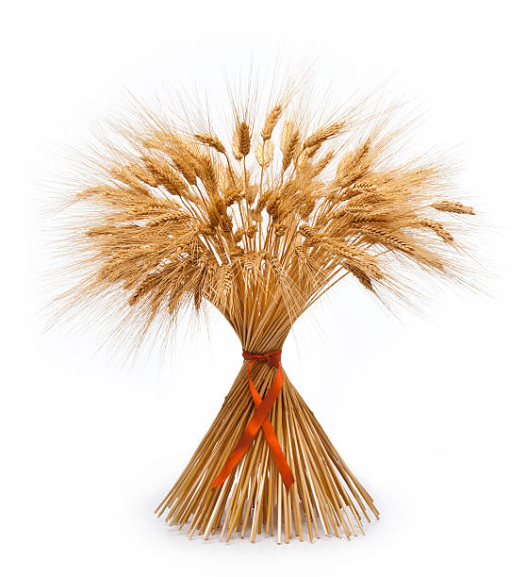
Ponder This!
The smoke of the red heifer BLOOD offering ASCENDED to the heavens.
Yahusha’s
Ascension
Blood Offering &
Firstfruit

Slide 58
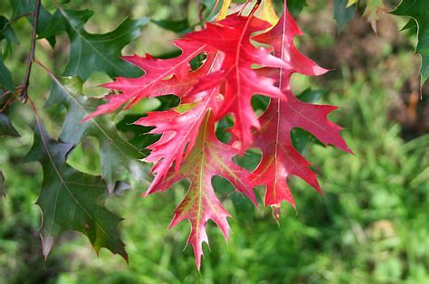
Within His captivity - was Yahusha taken to the Tabernacle first before His crucifixion?
If not, what are the consequences?
The Scarlet Oak
Lev 17:3-4

Slide 59
Shall we consider these commands too?
Lev 17:3 “Any man from the house of Yisra’ĕl who slaughters a bull or A LAMB or a goat in the camp, or who slaughters it outside the camp,
Lev 17:4 and does not bring it to the door of the Tent of Meeting, to bring an offering to יהוה [Yahuah] before the Dwelling Place of יהוה [Yahuah], blood-guilt is reckoned to that man. He has shed blood, and that man shall be cut off from among his people,
Lev 17:5 in order that the children of Yisra’ĕl bring their slaughterings which they slaughter in the open field. And they shall bring them to
יהוה [Yahuah] at the door of the Tent of meeting, to the priest, and slaughter them as peace offerings to יהוה [Yahuah.]
Yahuah issued this command (statute) specifically to prevent people from sacrificing to other “no-gods!”

Slide 60
The Locations for the Trial of Yahusha
John 18:13 -15, declares they led Yahusha to Hanan the father in law of Qayapha (High Priest) first, then they took Yahusha to Qayapha’s residence.
Matthew, Mark and Luke reveal closely the same details.
Yet we do not see that Yahusha – The Lamb of Yahuah, was taken to the Tabernacle for a proper sacrifice etiquette according to the sacrifice statute commands of Yahuah! Read again Lev 17:3-4.
The Jews being a portion of the house of Israel, were REQUIRED under statute command to accomplish this task, before slaying A sacrifice!
Were those Jews then “CUT OFF” from among their people?

Slide 61
Chose you this day whom ye will worship!
Because Yahusha - THE LAMB, was NOT taken to the Tabernacle for His Ultimate sacrifice,
WHICH “god” THEN
were the Sanhedrin, Pharisees, scribes sacrificing to?
It most certainly was not to Yahuah!
Do they then also assume the guilt – Lev 17:4 (b) … blood-guilt is reckoned to that man. He has shed blood, and that man
SHALL BE CUT OFF from among His people.

Slide 62

Why then are we continually advised to “go ask a rabbi”; priests who represent the same syncretized religion on whom this curse rests?
“CUT OFF”
– should we blindly trust this
moon worshipping religion of man?

Slide 63
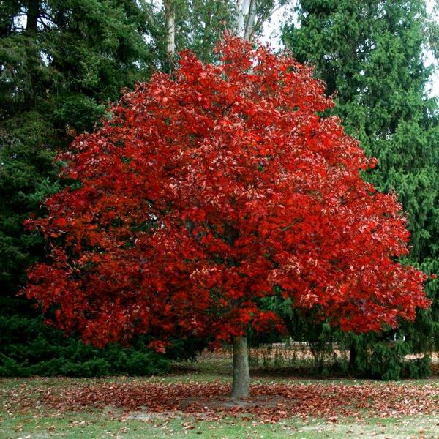
Was There a Qodesh Alter Outside of Jerusalem?
Scarlet Oak
Next!
What
Divine Entity sanctifies a Blood Offering?

Slide 64
The Fires of Sanctification
The fire of the alter is what purified and sanctified
the blood offerings.
1Ki 18:24 “And you shall call on the name of your mighty one, and I, I call on the Name of יהוה [Yahuah]. And the Elohim who answers by fire, He is Elohim.” So all the people answered and said,
“The word is good.”
Verse 30 – Elijah restored an alter that was broken down.

Slide 65
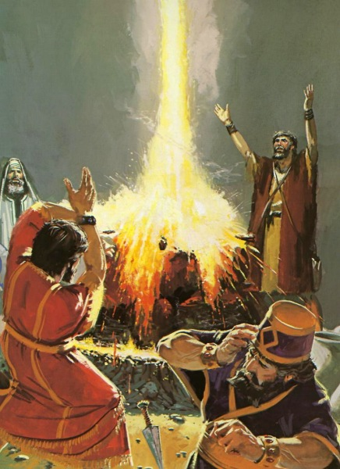
Yahuah - The Fire of Sanctification
1Ki 18:38 Then the fire of יהוה [Yahuah] fell and consumed the burnt
offering, and the wood and the stones and the dust, and it licked up
the water that was in the trench.
Heb 12:29 for indeed, our Elohim is a consuming fire.
The Fire - of sanctification,
purification & acceptance – OR
UTTER REJECTION
(Sodom & Gomorrah).

Slide 66
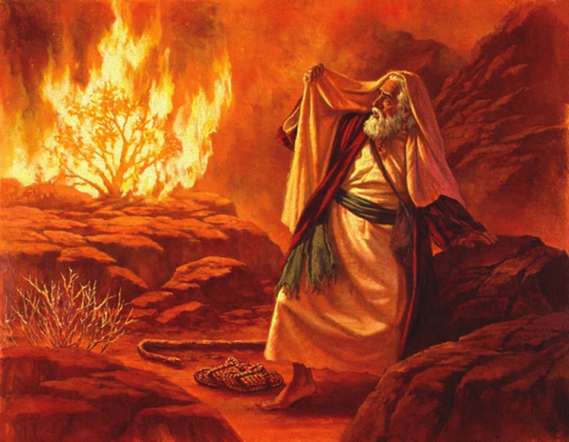
The Fire of Sanctification
Exo 3:2 And the Messenger of יהוה appeared to him in a flame of fire from the midst of a bush. And he looked and saw the bush burning with fire, but the bush was not consumed.
Deu 4:24 “For יהוה your Elohim is a consuming fire, a jealous Ěl.”

Slide 67
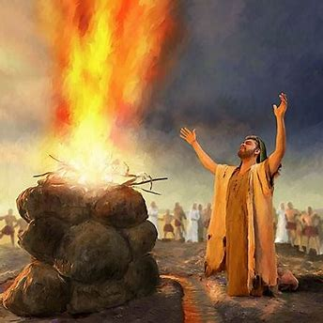
The Fire of Yahuah!
Most certainly we understand there was an alter at the location of the Tabernacle.
Did not David build an alter on the threshing floor of Ornan the Jebusite?

Slide 68
Was There a Qodesh Alter Outside of Jerusalem?
1Ch 21:26 And David built there an altar unto [Yahuah], and offered burnt offerings and peace offerings, and called upon [Yahuah]; and He answered him from heaven by FIRE upon the altar of burnt offering.
(This was on Mt Moriah which became the site of Solomon’s Temple.)
1Ch 21:28 At that time when David saw that [Yahuah] had answered him in the threshing floor of Ornan the Jebusite, then he sacrificed there.
Yah’s fire - a sign of approval by means of sanctification!
1Ch 22:1 Dawiḏ then said, “This is the House of יהוה Elohim, and this
is the altar of burnt offering for Yisra’ĕl.”

Slide 69
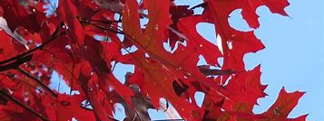
Scarlet Oak
Psa 22:6 But I am A WORM, and no man;
A reproach of men, and despised by the people.
Where does Yahusha stand?

Slide 70
And - a Worm!!! ?? What Worm?
Num 19:6 ‘And the priest shall take cedar wood and hyssop and SCARLET, and throw them into the midst of the fire
burning the heifer.
In Psalms 22:6, Yahusha is referencing Himself as a Worm (Towla).
Not just any worm, and most certainly not to the word - rimmah (H7415, fem noun), a worm exposing & connected to - corruption.
Yahusha links Himself with the Towla (H8415 masc. noun) that is proclaimed by Him; which through FIRE being transformed into ashes, is determined to CLEANSE people from defilement.
Most interesting; Yahusha links Himself to the feminine (mother) worm which provides – LIFE, by laying down her own LIFE – and also provides cleansing attributes and identification, specifically for her children!

Slide 71
Yahusha - THE WORM – PROVIDER OF LIFE!
Psalms 22:6 … “I am a worm”… - H8438
Numbers 19:6 … SCARLET, …
This gender aspect of Yahusha, a masculine identity, by linking Himself
to a feminine identity (a mother towla worm) who provides LIFE to His children, enables us a window into the Ruach Ha Qodesh (Holy Spirit) being identified with, or – linked to - a feminine gender!
Ruach – H7307 feminine noun.
Yahusha, by identifying Himself as a masculine noun, but metaphorically seen through the LIFE PROVIDING FUNCTION of the female worm,
DOES NOT MAKE YAHUSHA FEMININE!
And in likewise manner – by identifying the Ruach Ha Qodesh
(Holy Spirit) through a feminine noun, DOES NOT DETERMINE
the Ruach Ha Qodesh as feminine!

Slide 72
Qodesh Gender Job Descriptions Exposed
Psalms 22:6 … “I am a worm”… H8438
Numbers 19:6 … SCARLET, … H8438 & H8144
Yahusha is masculine.
The Ruach Ha Qodesh IS ONE AND THE SAME AS YAHUSHA, but in an invisible omnipotent, omnipresent format.
The GENDER FUNCTION IDENTIFICATION exposes and attaches the - DUTY DESCRIPTION PURPOSE
determined for the Ruach Ha Qodesh! (Holy Spirit)
This feminine gender identification DOES NOT PROVIDE A PLATFORM FOR LINKING THE RUACH HA QODESH TO THE
PAGAN FEMALE KABBALISTIC MYSTICAL SHEKINAH GODDESS!

Slide 73
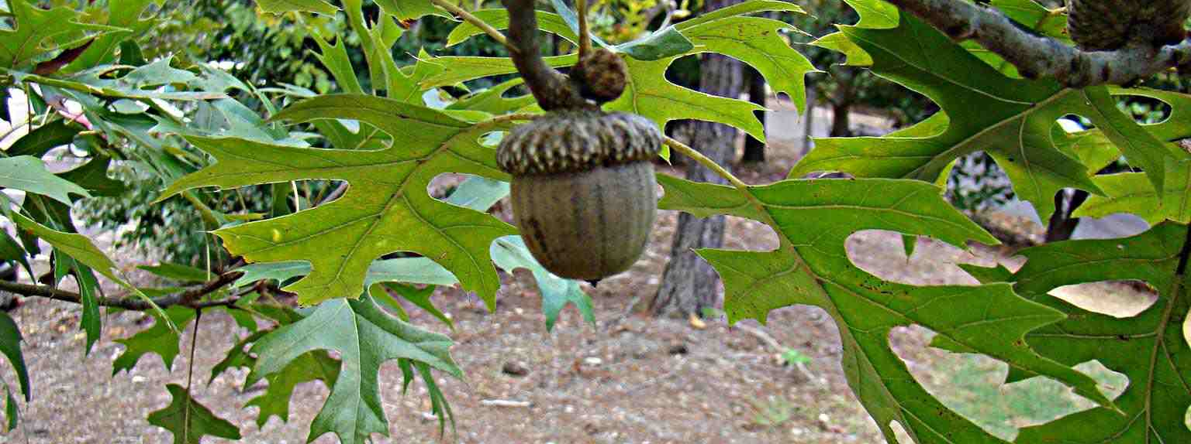
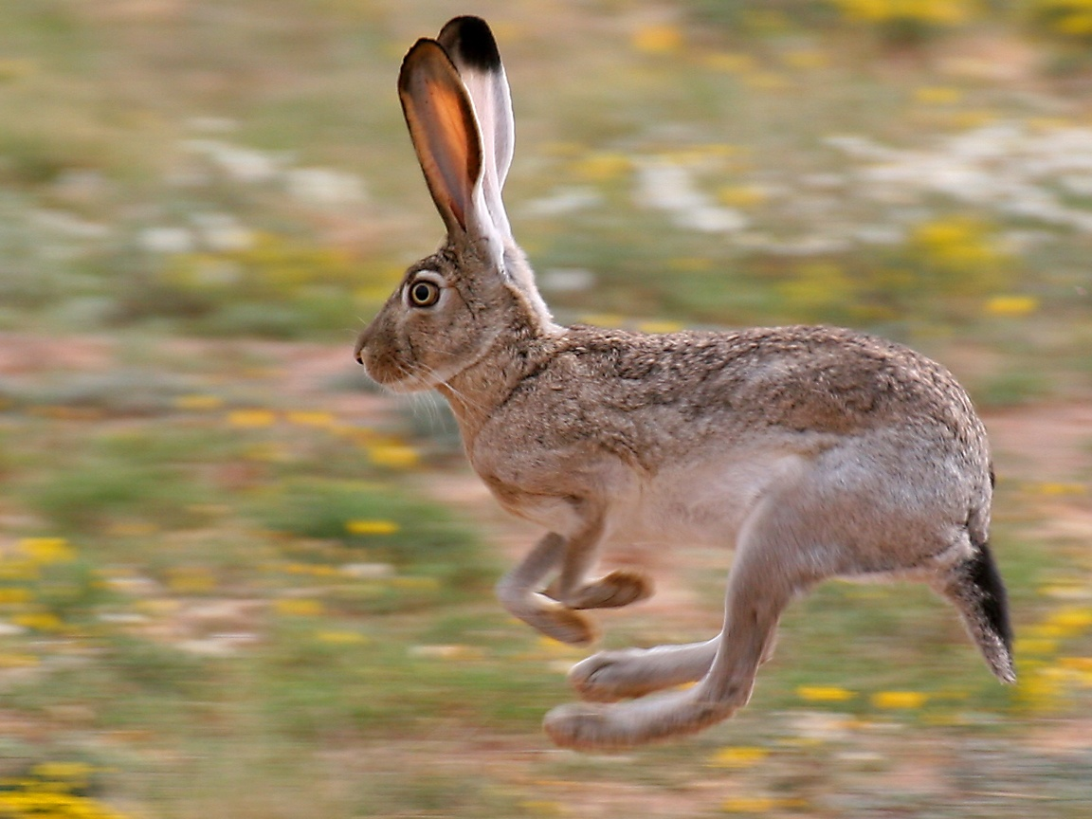
Let’s get back to Numbers! ☺
And “The Worm” as seen in Job!

Slide 74

The Worm and - Hyssop
Num 19:6 ‘And the priest shall take cedar wood and hyssop and SCARLET, and throw them into the midst of the fire burning the heifer.”
Hyssop is used for its cleansing qualities (Ps 51:7.) Hyssop placed into the Red Heifer fire, symbolizes the healing for the nations.
Note: John 19:29, hyssop carried the vinegar given to Yahusha as a means to quell (suppress) the pain of crucifixion. This was His personal “FIRE”!
Cedar, hyssop and scarlet were select items
specifically timed for the midst of the red heifer fire.
Timed for - When and Where the heat had the most intensity!

Slide 75
Heat of Intensity!
Can the midst of the week sacrifice (Dan 9:27), of Yahusha, be considered the point of His earthly life that had the most intensity?
The cedar wood; what is it about this wood that makes it qualify for the highly significant - timed for full intensity, offering to cleanse sin?
Wood is claimed to symbolize humanity. What is it that the ashes of the wood were destined for?
The ash mixture remains, of the wood and the red heifer, were specifically commissioned to cleanse humanity from contamination.
Num 19:9 And a clean man shall gather up the ASHES of the heifer, and shall place them outside the camp in a clean place. And they shall be kept for the congregation of the children of Yisra’ĕl for the water for uncleanness, it is for cleansing from sin.

Slide 76
Type Fulfillment!
Num 19:9a And a clean man shall gather up the ASHES of the heifer …
Mat 27:57 And when evening came, there came a rich man from Ramathayim, named Yosĕph, who himself had also become a taught one of יהושע.
Mat 27:58 He went to Pilate and asked for the body of יהושע.
Then Pilate commanded the body to be given.
Yoseph of Ramathayim, the “clean man” (for he personally accepted Yahusha the Mashiach) “gathered up” - took possession of, the “ASHES”
(the physical body).

Slide 77
Red Heifer Type Fulfillment!
Golgotha!
Num 19:9(b) - and shall place them outside the camp in a clean place.
Luk 23:50 -54 And see, a man named Yosĕph, a council member, a good and righteous man, - (v:51) he was not agreeing with their counsel and deed from Ramathayim, a city of the Yehuḏim, who himself was also waiting for the reign of Elohim, (v:52) he, going to Pilate, asked for the body of יהושע. (v:53) And taking it down, he wrapped it in linen, and laid it in a tomb hewn out of the rock, where no one was yet laid. (v:54) And it was Preparation day, and the Sabbath was approaching.
Clean!
Clean!
Mat 27:59 - 60 And having taken the body, Yosĕph wrapped it in clean linen, (v:60) and laid it in his new tomb which he had hewn out of the rock. And he rolled a large stone against the door
of the tomb, and went away.
Clean (Ashes in a CLEAN PLACE) !

Slide 78
Type Fulfillment!
Num 19:9 c And they [ashes] shall be kept for the congregation of the children of Yisra’ĕl for the water for uncleanness, it is for cleansing from sin.
John 4:14 “But whosoever drinketh of the water that I shall give him shall never thirst; but the water that I shall give him shall be in him a well of water springing up into
EVERLASTING LIFE.”
Both the red heifer ashes mixed with water, and the “spiritual water of Yahusha,” cleansed sin from people and led to a life of righteousness.
Yes, the Type – the red blooded heifer ashes mixed with water, was replaced or FULFILLED by Yahusha’s BLOOD - the Antitype!

Slide 79
In Ezekiel we find a prophesied type fulfilment with reference to the “clean water with ashes” derived from the Red Heifer sacrifice and Yahusha metamorphically applying it upon His chosen people.
Eze 36:24 “And I shall take you from among the gentiles, and I shall gather you out of all lands, and I shall bring you into your own land.
Eze 36:25 “And I shall sprinkle clean water on you, and you shall be clean – from all your filthiness and from all your idols I cleanse you.
Eze 36:26 “And I shall give you a new heart and put a new spirit within you. And I shall take the heart of stone out of your flesh, and I shall give you a heart of flesh,
Eze 36:27 and put My Spirit within you. And I shall cause you to walk in My laws and guard My right-rulings and shall do them.
See also - 11:19-20, 37:6-14, 39:29 for more restoration messages.
Alluding to the CLEANSING WATER TYPE of the Red Heifer ashes and water.

Slide 80
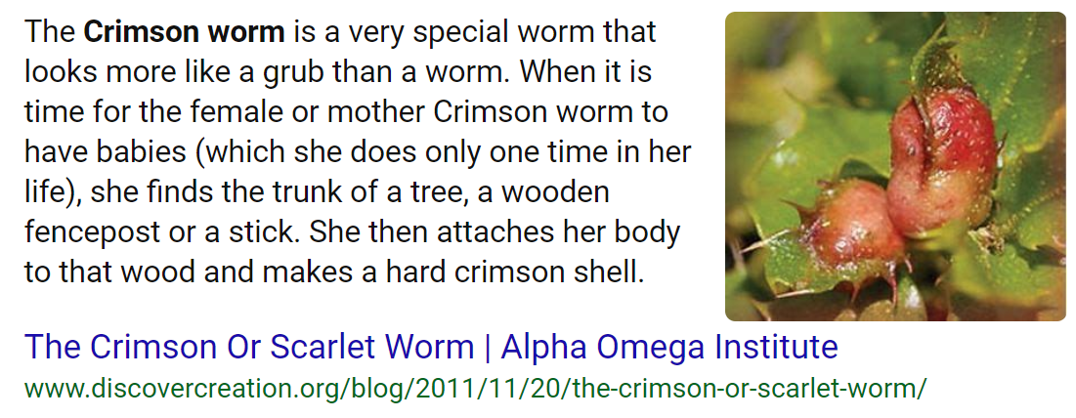
Worms in the Scriptures as seen by Job!
Next -
Who does Job liken to a “Worm?”

Slide 81
Job idenfies two different Worms!
Please note how Job identifies Yahusha –
Job 25:6
How much less man, that is a worm?
and the son of man, which is a worm?
Now, let’s break this down in the Hebrew words!
Here are the Strong’s numbers.
How much less man, ^{H582} that is a worm? ^{H7415}
and the son ^{H1121} of man, ^{H120} which is a WORM?
H8438

Slide 82
A Window into the 1st - “ Worm”
How much less man, ^{H582} that is a maggot? ^{H7415} HalleluYah Scriptures
H582 enosh(e) אנוֹש mmortal man
According to Gesenius Hebrew Chaldee Lexicon, this word is rarely used in a singular form.
H7415 ramah רמה hA sign of decay, to be exalted, to lift oneself up, (with a direct connection to idolatry.)
when taken back to the root H7311 the meaning of – to breed worms – is seen. Gesenius references Exo 16:20, when the manna grew worms and stank. Worms are a form of putrefaction. This is the 5th stage of death where the decomposition of proteins occur.
Mankind in his idolatrous habitation is likened to putrefaction.
The gravitation to idolatry reduces man to the final stage of death.

Slide 83
What about this - “ Worm” ??
and a son ^{H1121} of man, ^{H120} a worm? HalleluYah Scriptures
H1121 ben בן. a male child
H120 adam אדם . mankind, Adam the first man
H120 gives reference to a higher standard of mankind, that being the first stage of the life of Adam the first man, a purer blood, an uncorrupted life of righteousness (before the fall). It is here that an elevated position of purity is exposed.
A question now arises –
Who else - other than Adam - can be identified as having an undefiled life?
H8438

Slide 84
Who is THIS - “ Worm” ??
and a son ^{H1121} of man, ^{H120} a worm? ^{H8438} HalleluYah Scriptures
Who is THIS Worm?
The next section, Part #3, will positively identify this “Worm”!
Will the life and the death (3 - 24 hour cycles)
colour
a brilliant picture of the Crucifixion?
The End

Slide 85
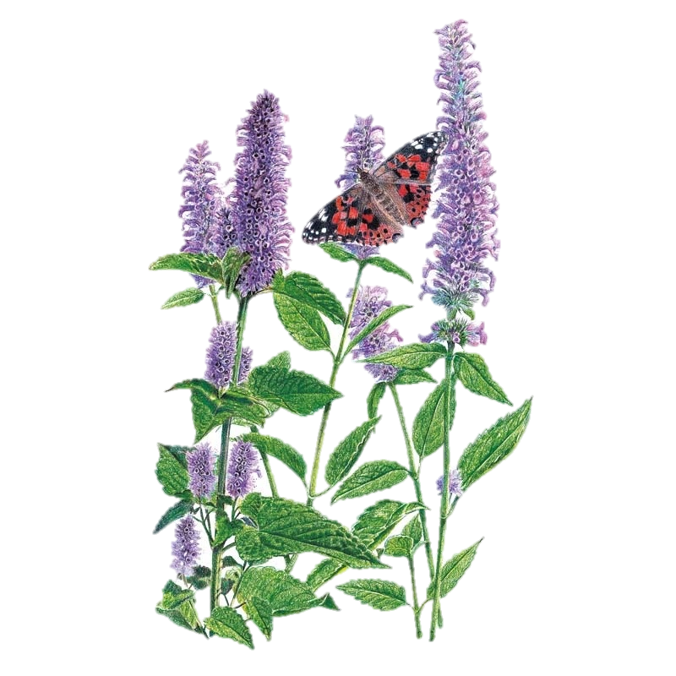
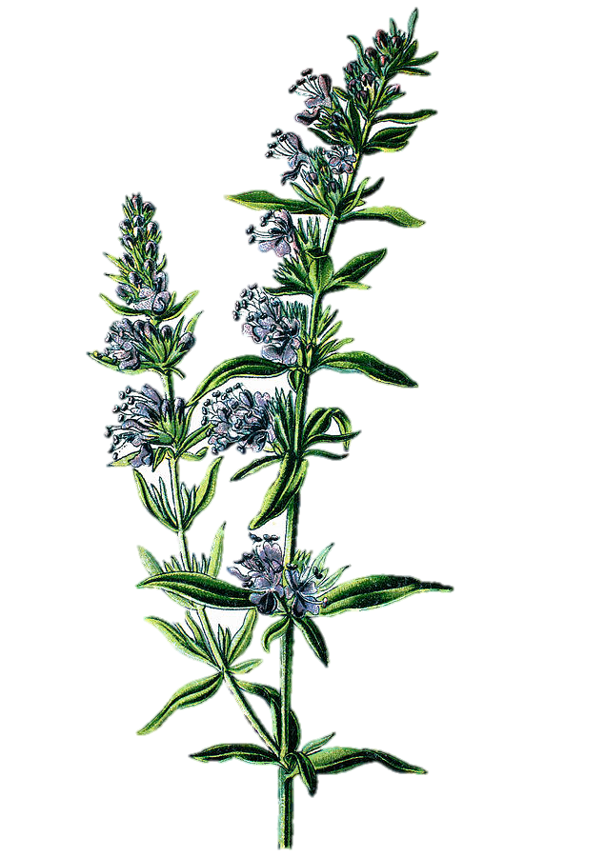
Thank you for your time and patience going through this material.
We look forward to Part #3, as it has some VERY revealing information exposing the DIRECT link from the Towla worm
to the very life and death of our Mashiach.
Once again, for your questions,
comments and concerns, please contact:
Charlene Fortsch or Timothy Astleford at:
Questions@studythecalendar.com
Hysop

Slide 86
